Slide 1
View
class overview

Slide 2
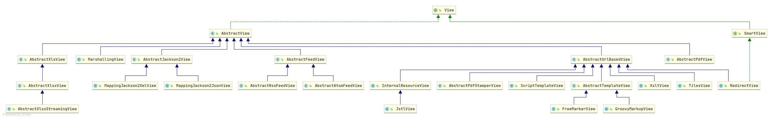
Class Diagram

Slide 3
Class
SmartView
AbstractView
AbstractXlsView
MarshallingView
AbstractJackson2View
MappingJackson2XmlView
MappingJackson2JsonView
AbstractFeedView
AbstractRssFeedView
AbstractAtomFeedView
AbstractPdfView
AbstractURLBasedView
InternalResourceView
JstlView
AbstractPdfStamperView
ScriptTemplateView
AbstractTemplateView
FreeMarkerView
GroovyMarkupView
XsltView
TilesView
RedirectView

Slide 4
AbstractView
Abstract base class for View implementations. Subclasses should be JavaBeans, to allow for convenient configuration as Spring-managed bean instances.
renderMergedOutputModel()
Subclasses must implement this method to actually render the view.
Note

Slide 5
AbstractURLBasedView
Abstract base class for URL-based views. Provides a consistent way of holding the URL that a View wraps, in the form of a “url” bean property.

Slide 6
InternalResourceView
Wrapper for a JSP or other resource within the same web application. Every view name returned from a handler will be translated to a JSP resource
JstlView
Specialization of InternalResourceView for JSTL pages, i.e. JSP pages that use the JSP Standard Tag Library.

Slide 7
AbstractPdfStamperView
Application-specific view classes will extend this class to merge the PDF form with model data.
mergePdfDocument()
Subclasses must implement this method to merge the PDF form with the given model data.

Slide 8
ScriptTemplateView
Designed to run any template library based on a JSR-223 script engine. (javascript)
javax.script package
All methods implemented

Slide 9
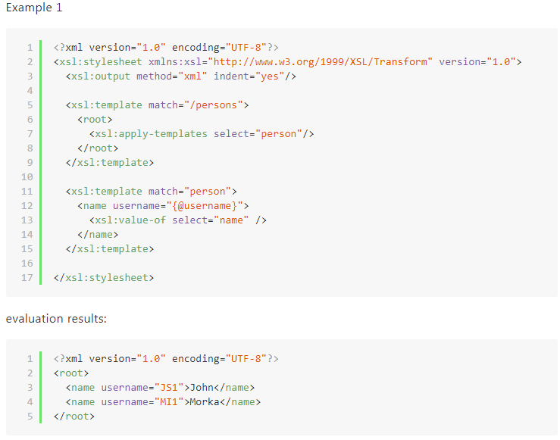
XsltView
XSLT-driven View that allows for response context to be rendered as the result of an XSLT transformation.
javax.xml package

Slide 10
TilesView
View implementation that renders through the Tiles Request API. The “url” property is interpreted as name of a Tiles definition.
org.apache.tiles package

Slide 11
RedirectView
View that redirects to an absolute or context relative URL. The URL may be a URI template in which case the URI template variables will be replaced with values from the model or with URI variables from the current request.

Slide 12
AbstractPdfView
uses Bruno Lowagie’s iText API
buildPdfDocument()
Subclasses must implement this method to build an iText PDF document, given the model.
renderMergedOutputModel()
Subclasses must implement this method to actually render the view.

Slide 13
External
Class
WebApplicationObjectSupport
Interface
ApplicationContextAware
ServletcontextAware
InitializingBean
BeanNameAware
Package
javax.xml
javax.script
org.apache.tiles
com.lowgie.text.pdf

